Slide 1
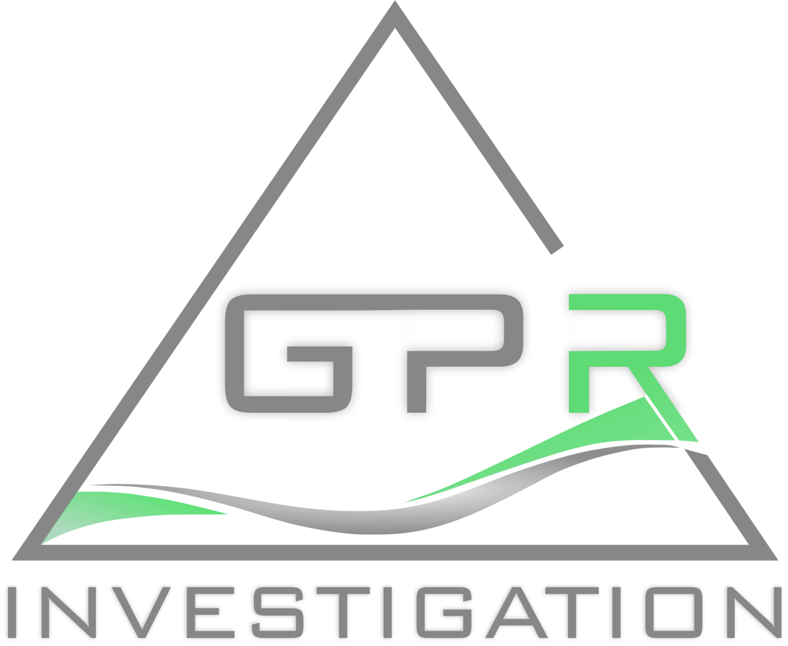
PRESENTATION OF THE COMPANY

Slide 2
Introduction
GPR INVESTIGATION was founded to provide high level Geophysical, Geological & Mining consultancy services. Our experienced team of geologists and mining experts will support you in gaining value to your projects, taking essential decisions, and reaching your milestones.
Thanks to our broad network of internationally renowned partners we base our services on a very broad portfolio of techniques following the highest standards.
Please find a short presentation of our services on the following slides.

Slide 3
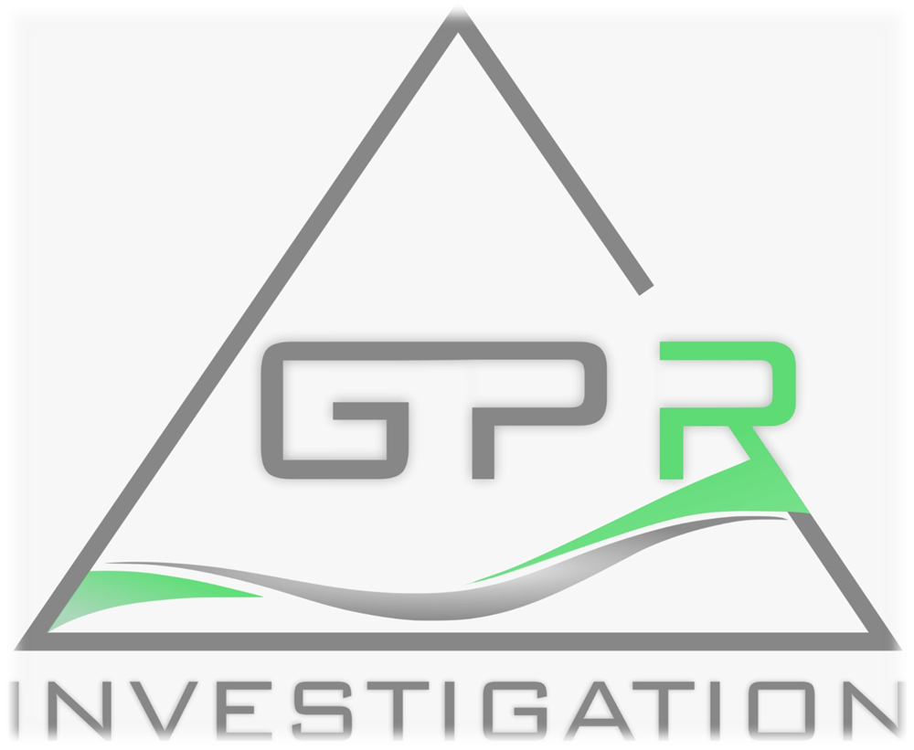
Agenda
1 ABOUT US
2 OUR SERVICES
3 OUR EXPLORATION PROJECTS

Slide 4
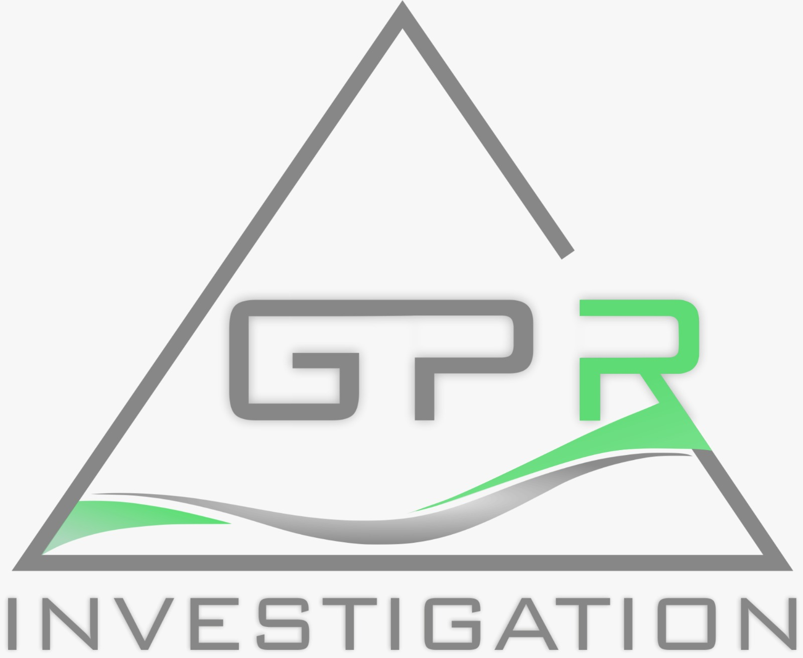
About Us
GPR INVESTIGATION provides geological consulting, exploration management, and contract geological services to the global mining and exploration industry. Our team is experienced in all stages of the mining cycle, from greenfield exploration through to development, and initial production, to full-scale operation. We strive for technical excellence and aim to exceed client expectations on every engagement.

Slide 5
The Standards We Follow
Australasia – JORC Australasian Code for Reporting of Exploration Results, Mineral Resources and Ore Reserves
National Instrument 43-101 (the "NI 43-101" or the "NI") is a national instrument for the Standards of Disclosure for Mineral Projects within Canada

Slide 6
Our Service Areas
MINERAL
EXPLORATION
MINING
GEOTECHICS
GEOLOGY & RESOURCES
MINING

Slide 7
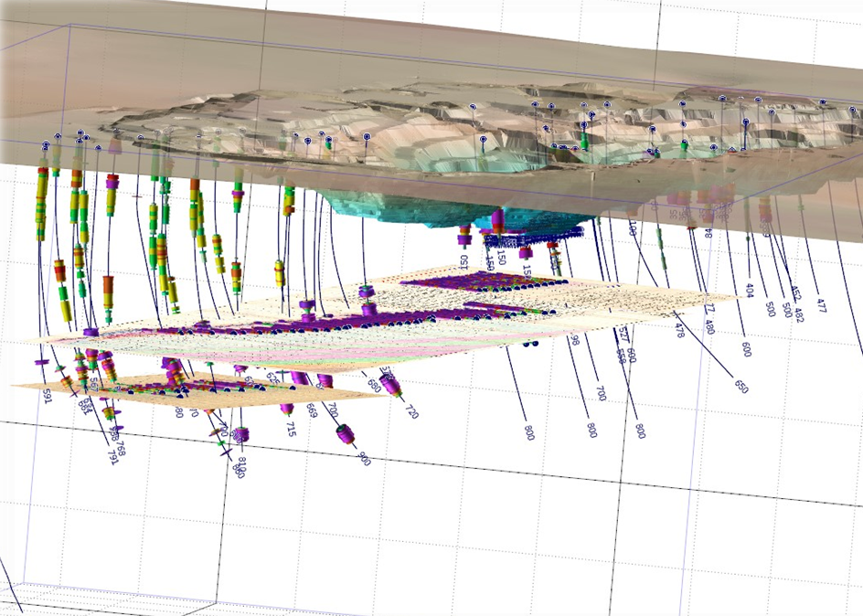
Mineral Exploration
SERVICES
Mineral Exploration Targeting
Remote Sensing & Geophysics
Exploration Geochemistry
Mineral Exploration Project Planning
Exploration Sampling, Analysis, QA/QC
Mineral Exploration Field Services
Exploration Project Audit & Valuation
Service Portfolio

Slide 8
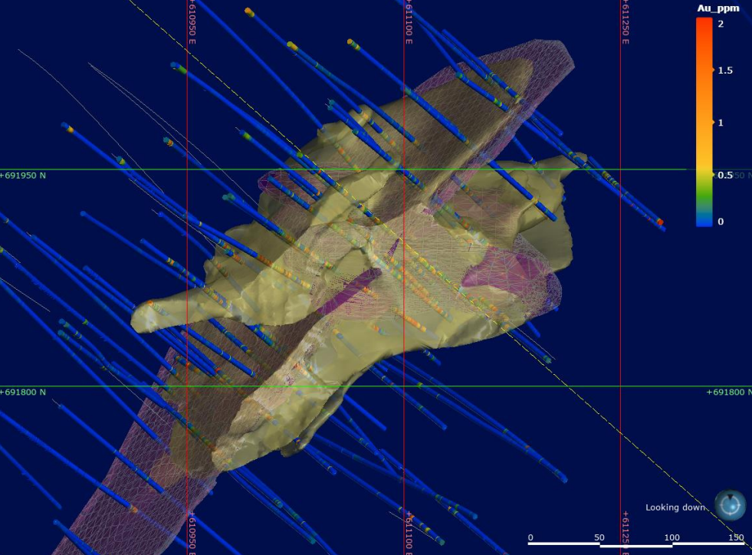
Mineral Exploration
SERVICES
Hyperspectral logging
Data management
Machine learning
Micromine, Surpac
Arc Gis in remote sensing
QGIS in remote sensing
Techniques
NI 43-101
JORC
Other recognized practices
Reporting

Slide 9
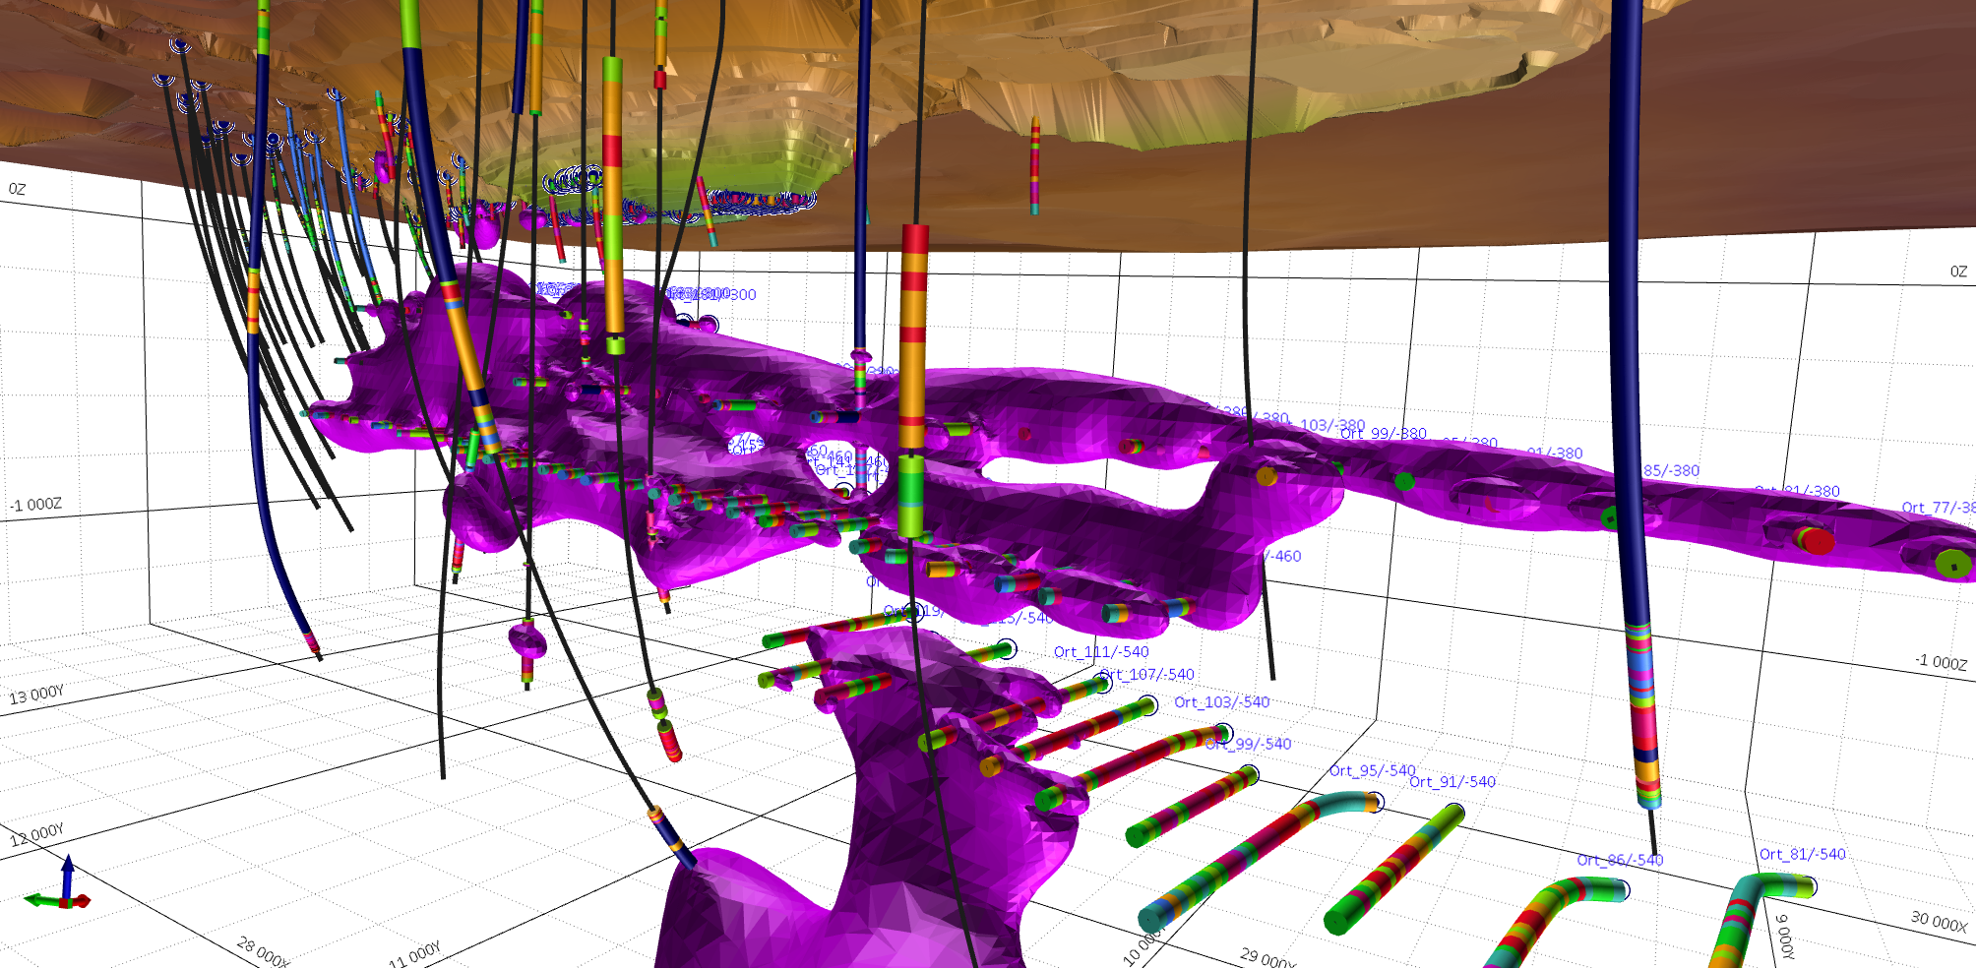
Mineral Exploration
WORKING APPROACH
We ensure effective application and interpretation of geology, geochemistry, and geophysics to generate and test exploration targets. Since “blind” orebodies are of increasing importance, we routinely use a mineral systems approach to assess prospectively. Our team is highly proficient in 3D visualization using software such as Micromine, and Surpac and working with advanced exploration databases.

Slide 10
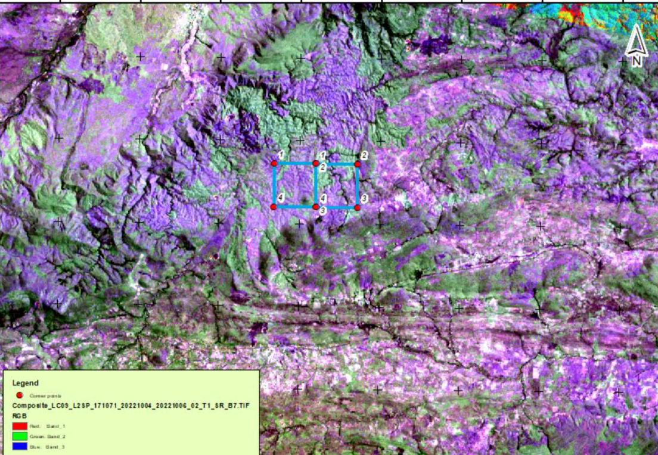
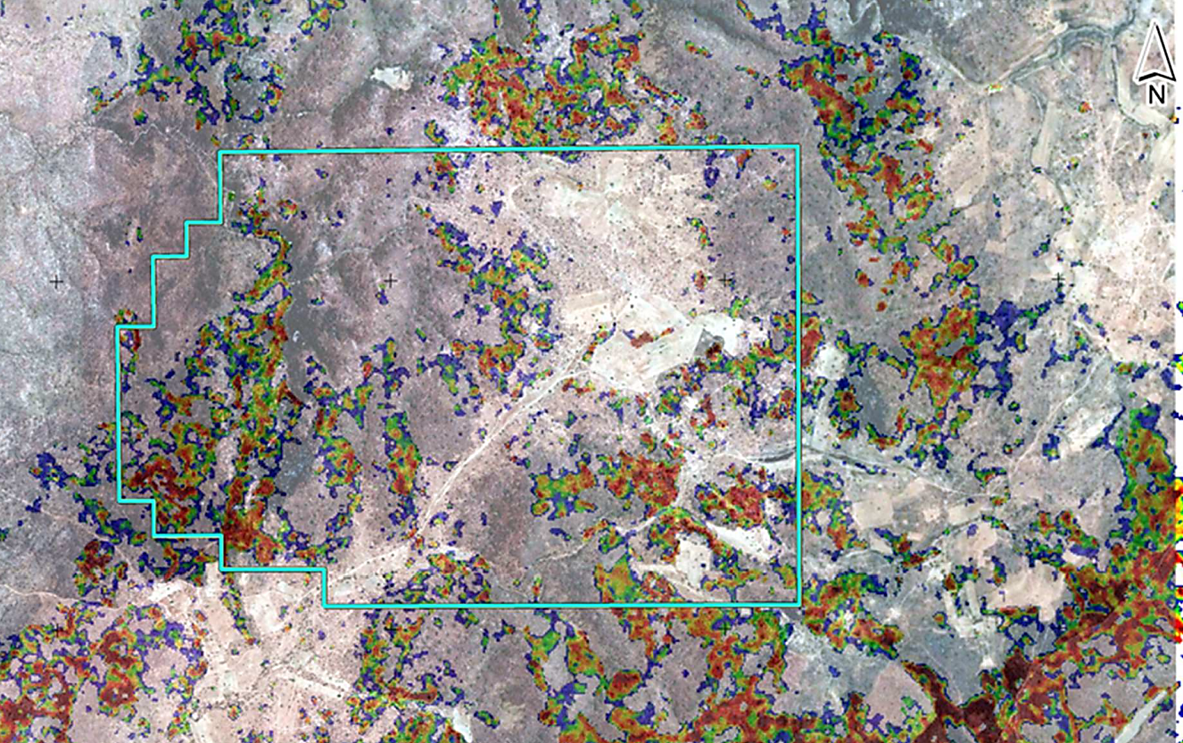
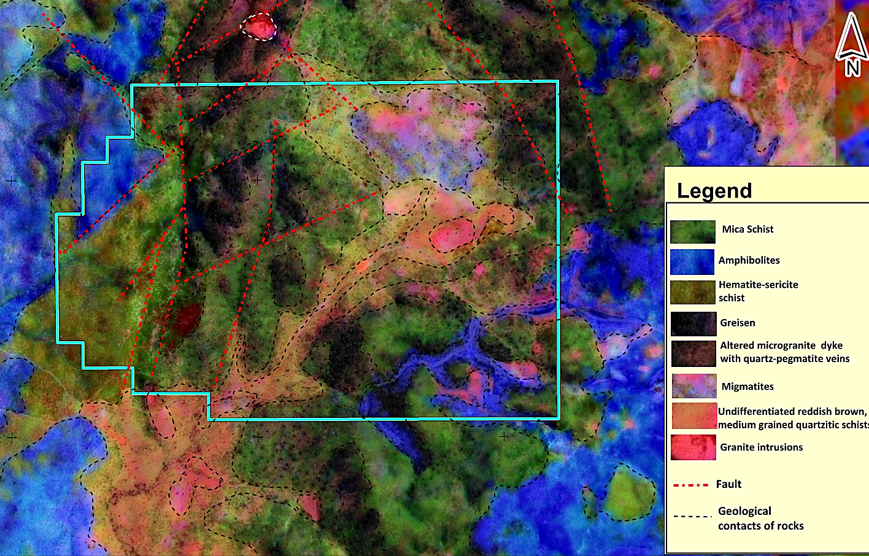
Mineral Exploration
REMOTE SENSING & GEOPHYSICS
We interpret remotely sensed data using a sound structural geological understanding to provide informed, integrated interpretations that can be directly applied to exploration targeting.
Specializing in process-driven conceptual models allows us to improve the understanding of your mineral targets. By using multiple data sets, our highly experienced geologists solve geological ambiguities not resolvable before.

Slide 11
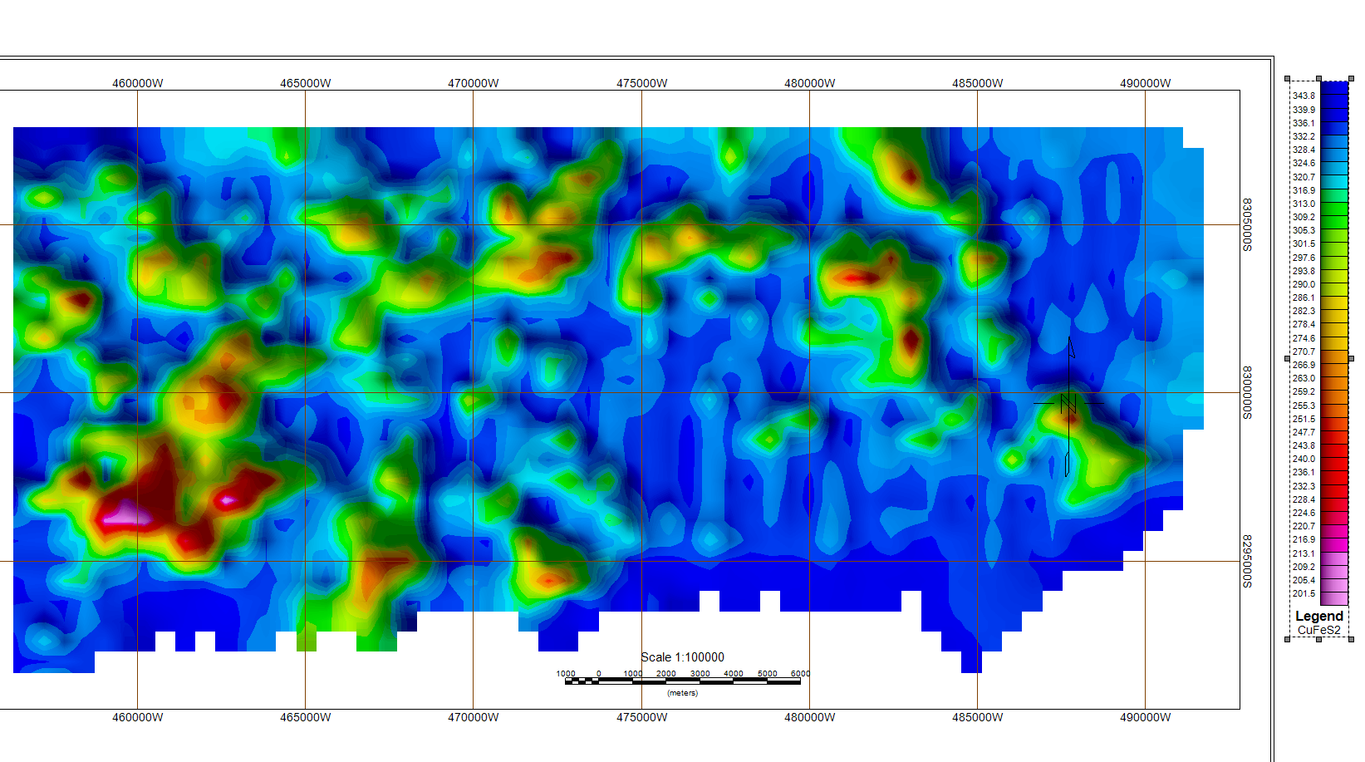
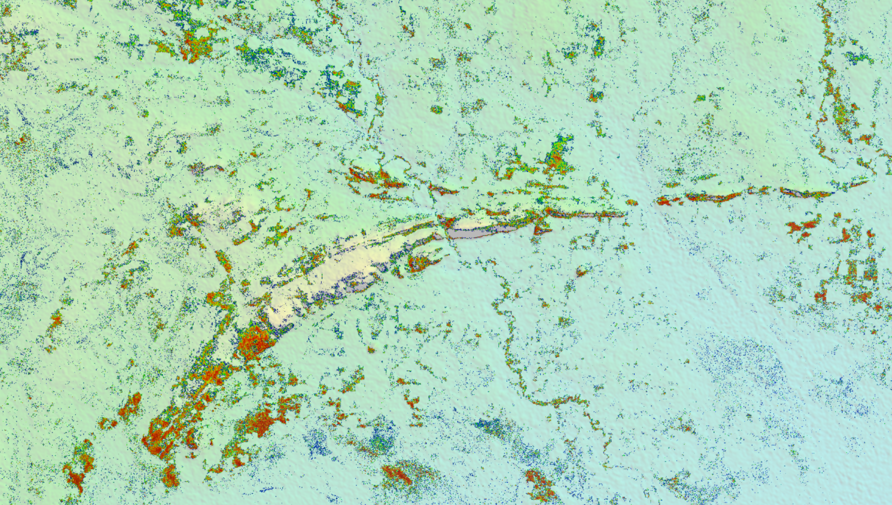
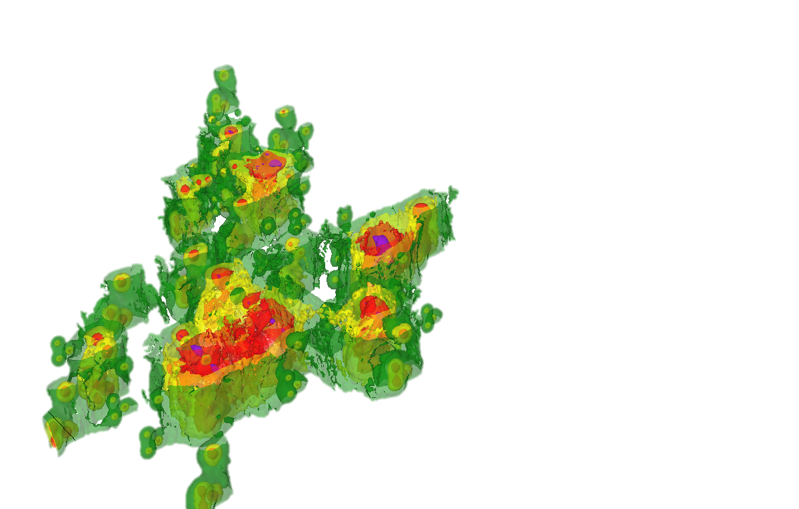
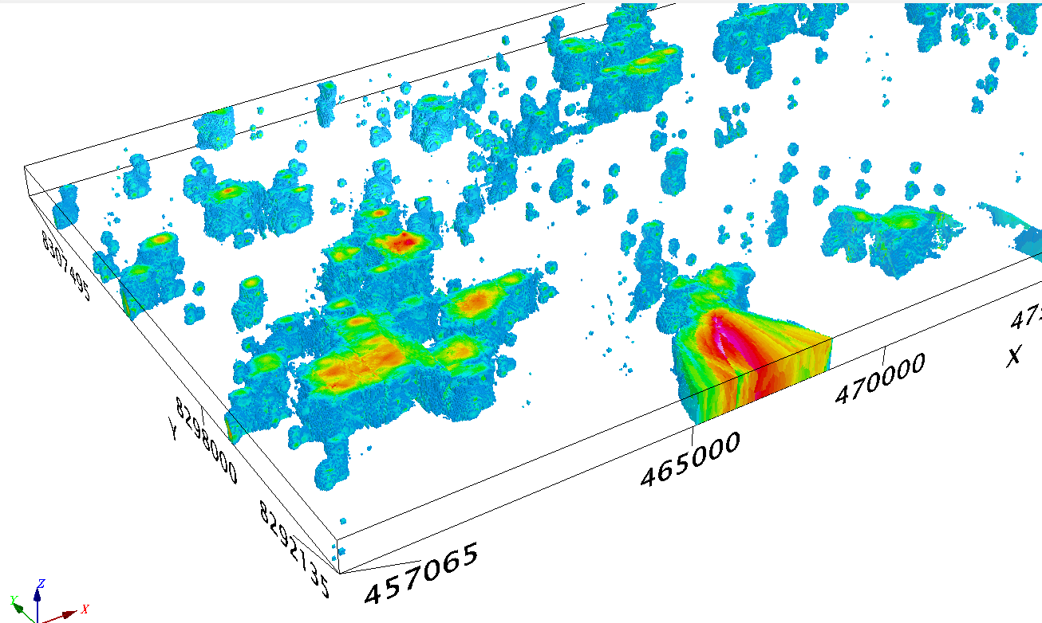
Mineral Exploration
REMOTE SENSING & GEOPHYSICS
Interpretation and targeting based on satellite spectral survey data using Sentinel-2 infrared [VNIR] and shortwave infrared [SWIR] satellite data for Cu-Co-Au exploration.
The data of the visible spectrum of the mineral is interpreted, then the correlation of a particular visible spectrum is compared with the data from the USDS mineral spectral data library. Using the data inversion method (similar to processing geophysical survey data), we obtain a model of a ready-made target for further exploration (isosurface of the proposed mineralisation), with more refined spatial and geometric characteristics, which greatly simplifies the identification of targets for exploration over large areas.

Slide 12
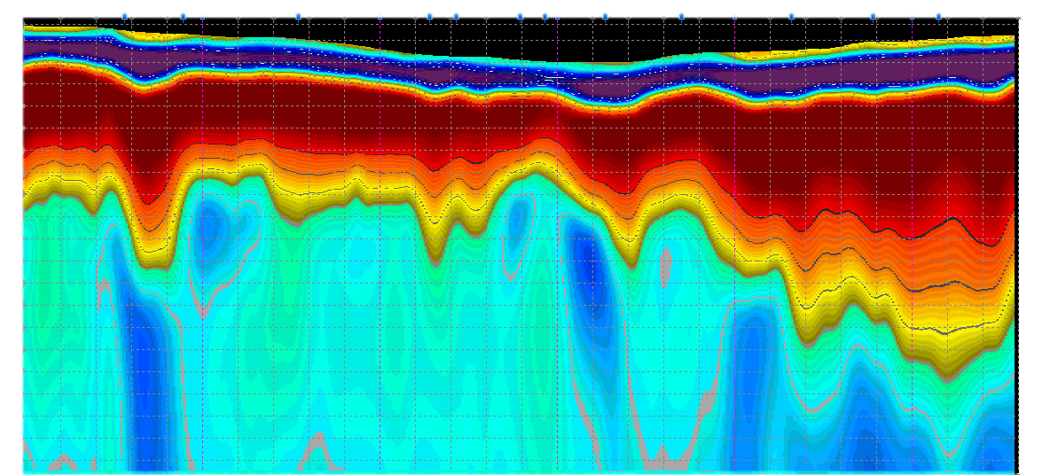
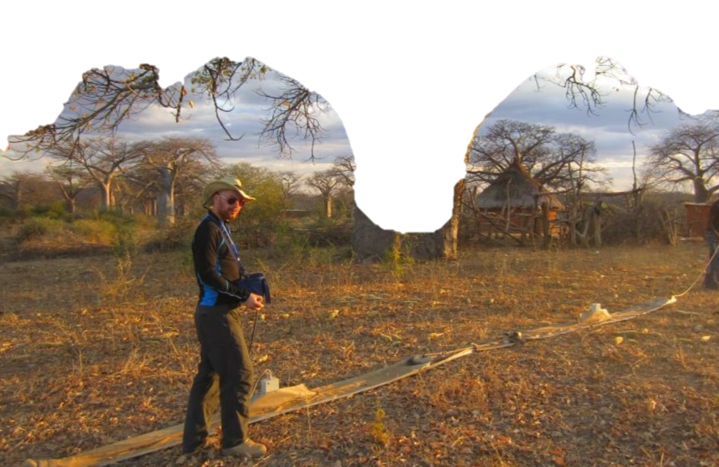
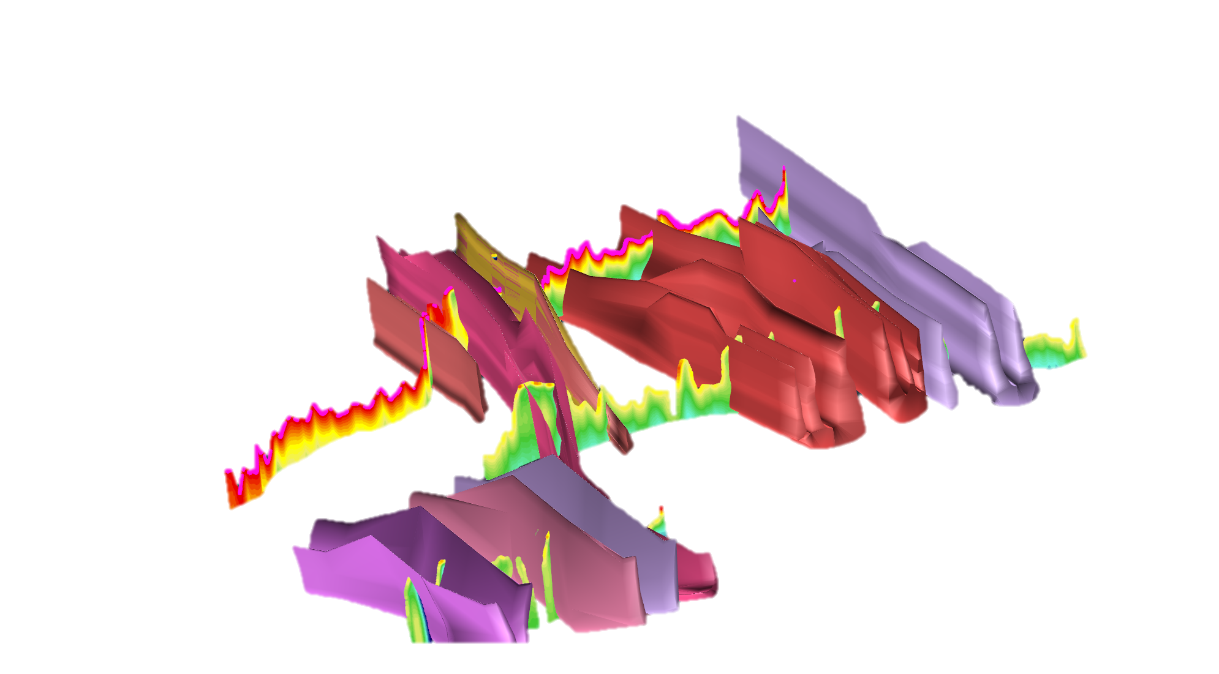
Mineral Exploration
GPR PROFILING
In geophysics, many consider ground penetrating radar as an exploration tool/technique that only provides images at shallow depths. This opinion is absolutely true for most GPRs built on traditional architecture. However, we use the Loza-2N "DeepGPR" low-frequency georadar, which implements and develops low-frequency solutions and principles that allow us to obtain data from depths of hundreds of meters.In order to reduce the risks of geological exploration work, as well as reduce the cost of geological exploration work, our company proposes to use a geophysical exploration method based on the method of high-resolution electromagnetic waves (15-50 MHz) to obtain a refined section, determine the geometry of the main geological structures, ore veins and stockworks.

Slide 13
Mining
SERVICES
Mining Project Estimation
Mine Engineering
Mine Waste Management
Extractive Metallurgy & Mineral
Project Management
Mining & engineering studies (concept to feasibility)
Reserve assessment reviews
Mine optimization, scheduling & design
Ore Reserve estimation & reporting
Grade control & reconciliation
SW: Micromine, Geovia, Surpac
Portfolio
Techniques

Slide 14
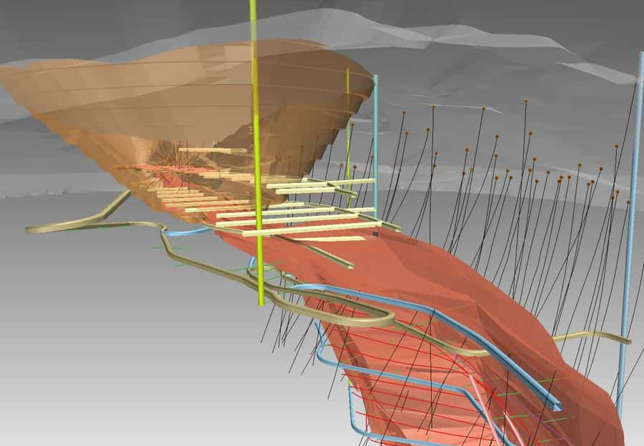
Mining
WORKING APPROACH
Our expert team is backed by decades of senior level experience – as executives, managers, operators and technical specialists. We draw on this experience and knowledge to add value to your mining project in the following keyways:
Delivering results that satisfy the technical diligence requirements of investors, so they can make investment decisions.
Adopting an integrated approach, by working closely with geologists and other technical experts, to ensure solutions are practical and effective.
Assisting with accurately delineating ore and waste, and correctly planning and scheduling material movements to optimize metal production and profit.

Slide 15
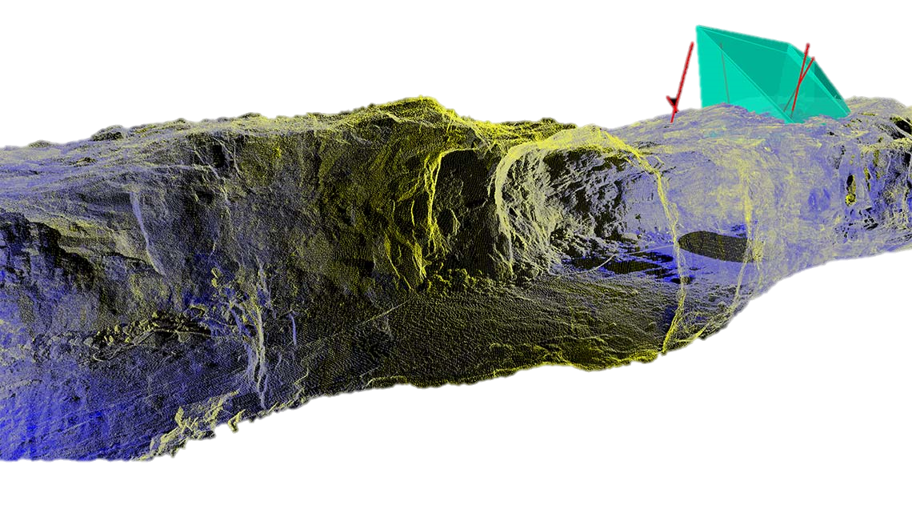
Mining Geotechnics
SERVICES
Geotechnics for Mining Infrastructure
Mining Geotechnical Investigation
Underground Rock Mechanics
Pit Slope Stability
Geotechnical Numerical Modelling
Geotechnical Operational Support
Geotechnical Instrumentation
Ground Support Quality Control
Geotechnical Core Logging
Rock Property Testing
Drill hole/ rock bolt camera inspections
SW: SVDESIGNER, PLAXIS LE
Techniques
Portfolio

Slide 16
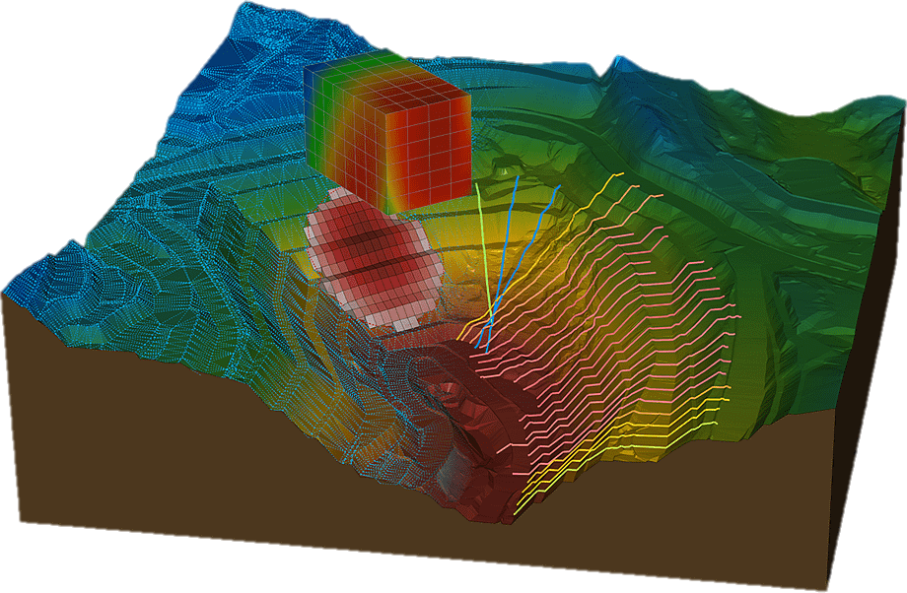
Mining Geotechnics
WORKING APPROACH
By providing clear, comprehensive design options and assessing their associated time- and mining-related risks, we will help you make informed decisions based on your specific needs and risk profile.
We work in environments ranging from equatorial to permafrost at surface, shallow, and deep levels and have expertise in diverse mineral commodities, including base and precious metals, coal, iron ore, bauxite, diamonds, and industrial minerals. Our specialists also have multiple-method mining and infrastructure experience and design and implement support systems to deal with accelerated erosion from construction, ground disturbances, and waste disposal.

Slide 17
Geology and Resources
SERVICES
Structural Geology
3D Geological Modelling
Mineral Resource Estimation
Mineral Reserve Estimation
Scoping Studies
Pre-feasibility studies
Feasibility Studies
Mine Site Operational Support
QA/QC of data & data collection techniques
Geological & geo-metallurgical modelling
Geostatistical analysis & variography
Mineral Resource Estimation, validation & classification
Reporting in accordance with international codes
Resource audits & risk analysis
Micromine, Surpac
Techniques
Portfolio

Slide 18
Geology and Resources
WORKING APPROACH
Base your decisions on our interpretation of the structural setting of ore deposits and our recommendations for specialized drilling, sampling, and assaying techniques.
We use 3D modelling software combined with statistical and geostatistical methods to model commodity distribution. Our experts integrate complex datasets to generate and refine targets and identify controls on mineralization. We map open pit and underground mines and improve grade control, ore reserve modelling, mine plans, and near mine drill targeting.

Slide 19
We will find a solution for you!
LET'S EXPLORE OUR WORLD TOGETHER!

